Slide 1
Construction Management Information System
By: Artur Komissarov, Faith-Valentine Uzoka, Khaliq Minsariya, Krushnam Badami,
Kyle Rumde,Srinath Bhaskaran, Varnika Srivastava

Slide 2

ROADMAP
Overview Statement
Goals of the IS
Modelling Functional Requirements
Use Case Specification
Draft Conceptual Model
1
3
5
7
9
2
4
6
8
Determine Customers/ Users
Requirements Identification and Classification
Events
Use Case Diagram

Slide 3
Overview Statement: The purpose of the Project
The purpose of our project is to develop an information system for construction management that covers all stages of a construction project, with a website that can:
Integrates communications into one interface which is capable of:
Coordinating construction workers
Aiding in planning between architects, managers, and construction professionals
Automating tasks,analytics, and reporting to:
Reduce the chance of errors
Automatically generate reports and charts/visualizations
Saves time with:
Resource acquisition
Scheduling
Monitoring
Aid management in:
Project sites
Inventory
Finances
Safety
Reduce cost

Slide 4

2. Determine Customers/Users

Slide 5

Primary Users - Managers
Project manager
Overseers of the project
Keep everything on track!
Resource manager
Procurement of equipment and materials
Determines the number people power needed for the project
Inventory manager Obtain and distributor of resources
Equipment tracking
Field manager
Manages the operations at a construction site
Reports progress on the site, as well as field reports
Keeps track of incidents
Distributor of schedules
Safety manager
Ensures safety at all activities the safety manager is interested in:
Daily operations at the site
Blueprint confirmation
Incident reports
Data analysis
Finance manager
Budget realizer, adherer, and enforcer!

Slide 6

Secondary Users - Team Members
Architects
Blueprint maker, discusses with the client
Construction workers
The backbone of construction activities
Construction Professionals
A worker with unique skills and assets
Ex. a electrical engineer, utility engineer, etc
Can also determine the time needed to complete the construction project

Slide 7

Customers - Stakeholders
Supplier
Where we will procure what is needed for the construction project endeavour!
Clients
Payers of the project endeavour
Have a saying on what they expect out of the project
Secures a budget alongside with the sponsors

Slide 8
3. Goal of the IS

Slide 9

Achieve the following:
Automation of managerial tasks
Integrate communications, all visible in one centralized interface

Slide 10
4. Requirements ID
and Classification

Slide 11
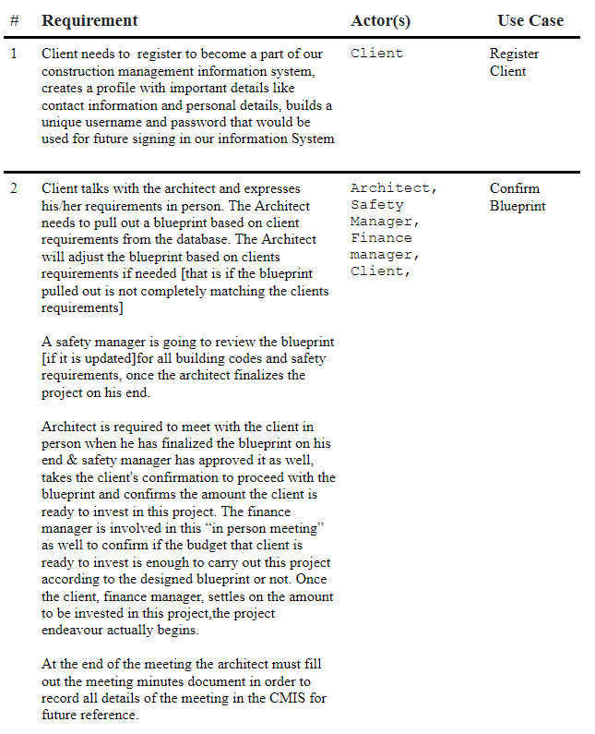

Slide 12
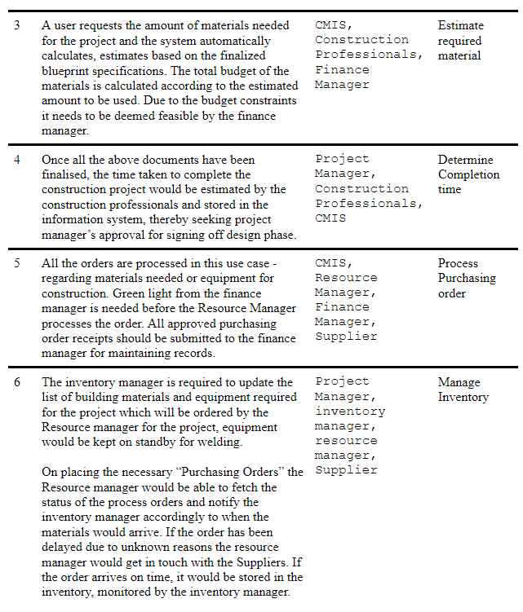

Slide 13
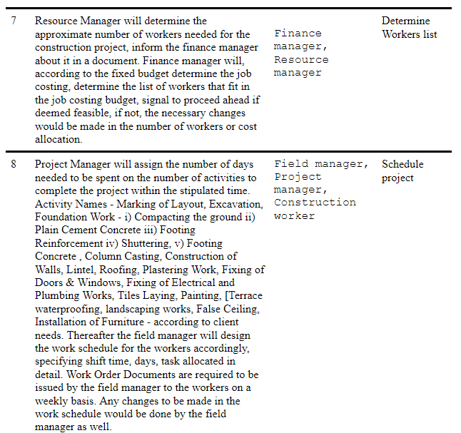

Slide 14
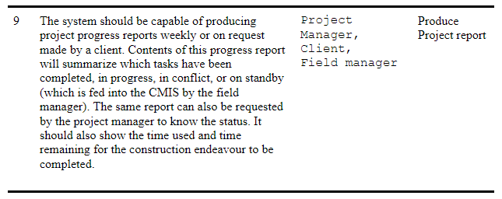

Slide 15
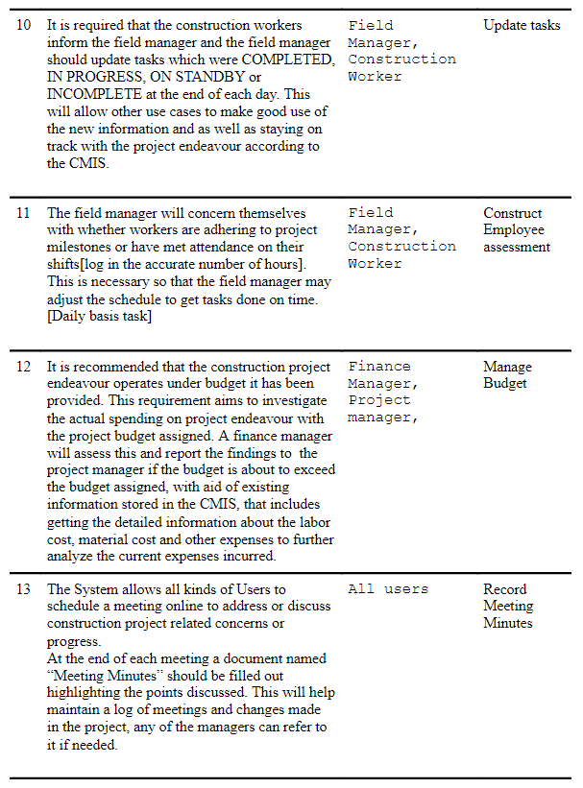

Slide 16
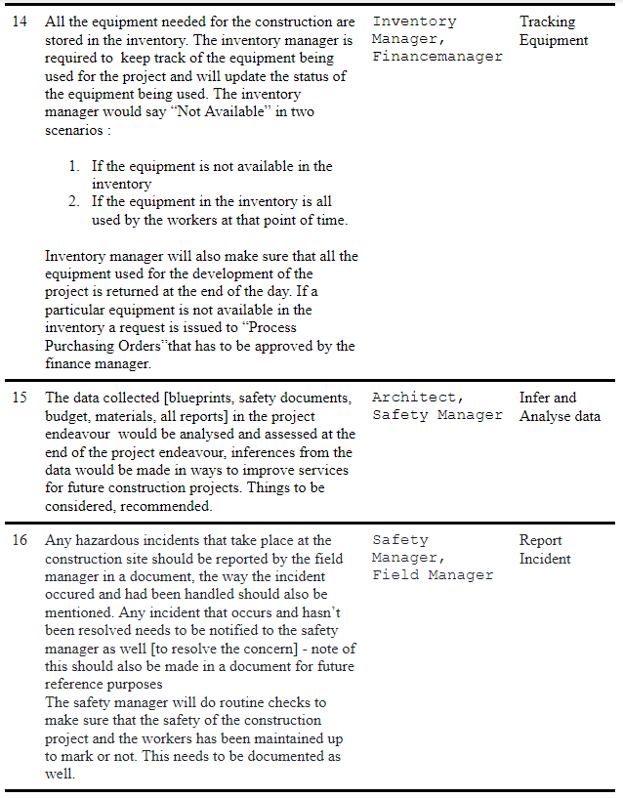

Slide 17

Elicitation techniques
Discover the requirements
Avoid Tacit knowledge
Three elicitation techniques to take:
Reading/Document Analysis
Brainstorming Sessions
Observation

Slide 18
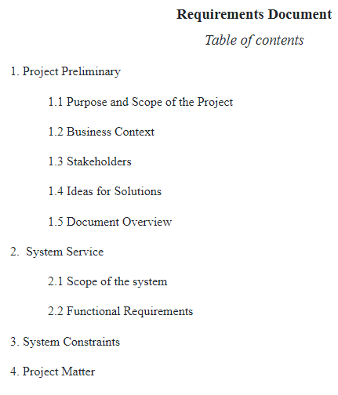
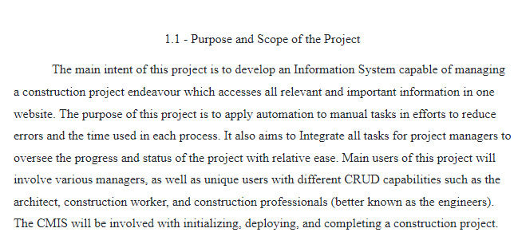
Requirements Document

Slide 19
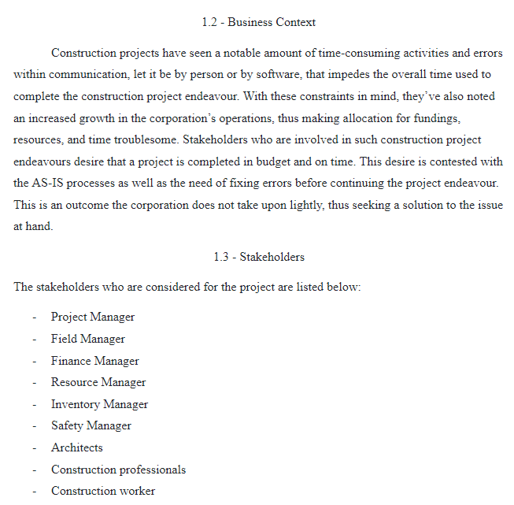
Requirements Document

Slide 20
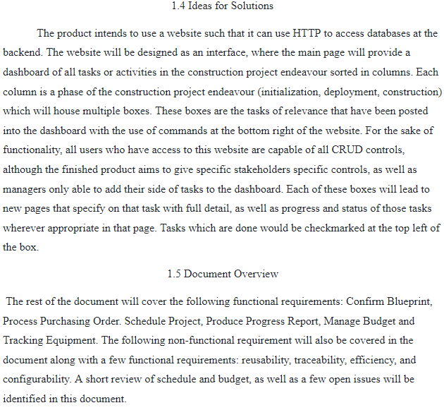
Requirements Document

Slide 21
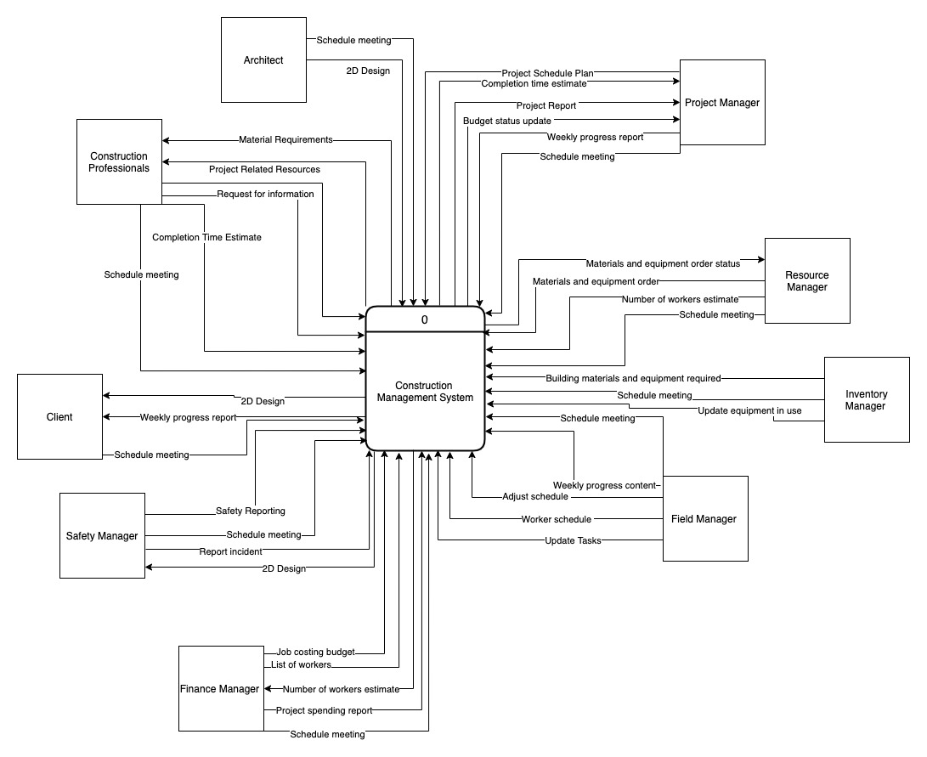
Requirements Document

Slide 22
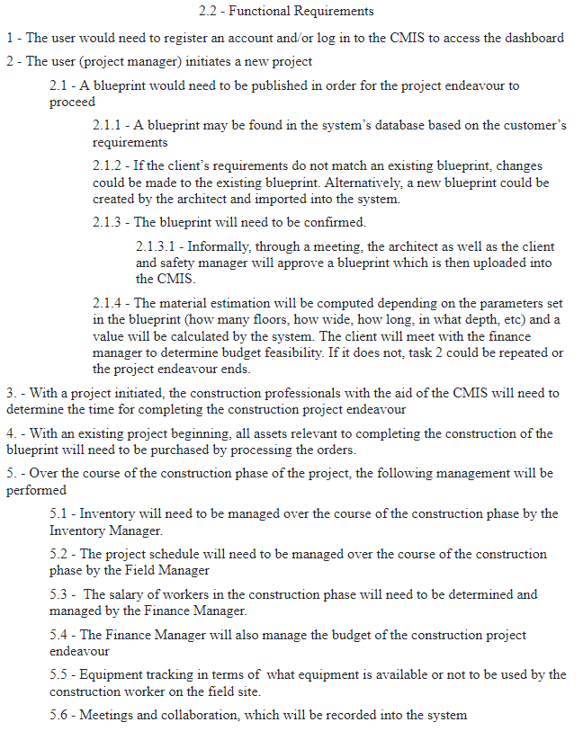
Requirements Document

Slide 23
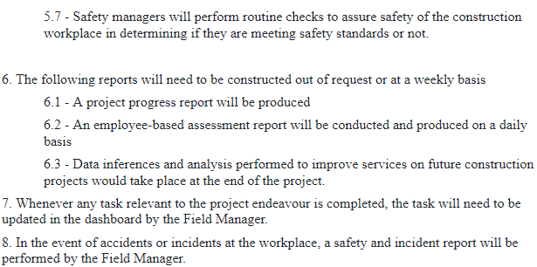
Requirements Document

Slide 24
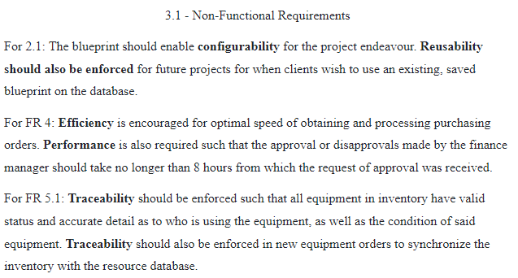
Requirements Document

Slide 25
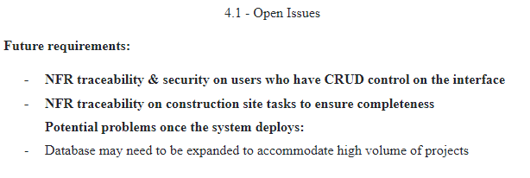
Requirements Document

Slide 26
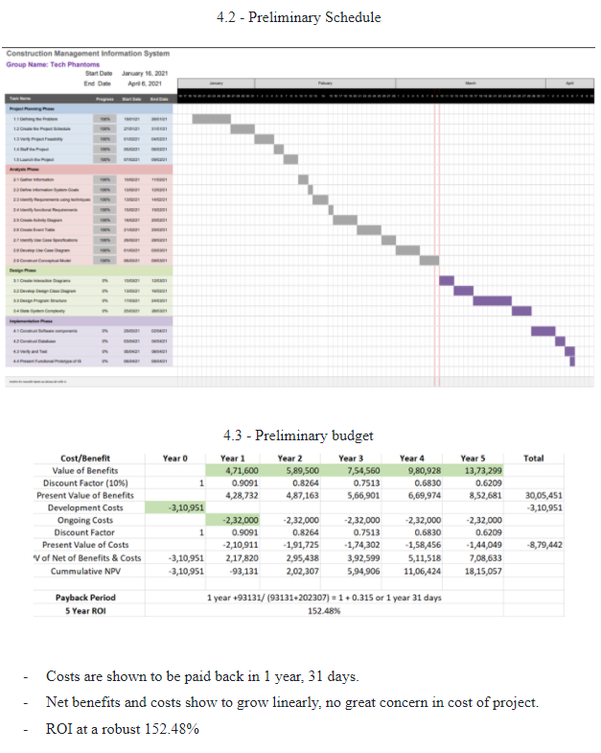
Requirements Document

Slide 27
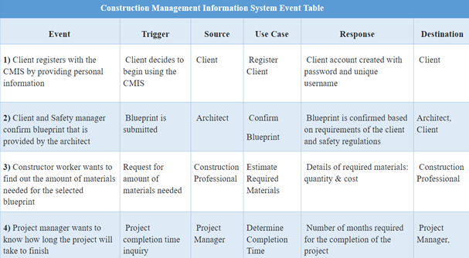
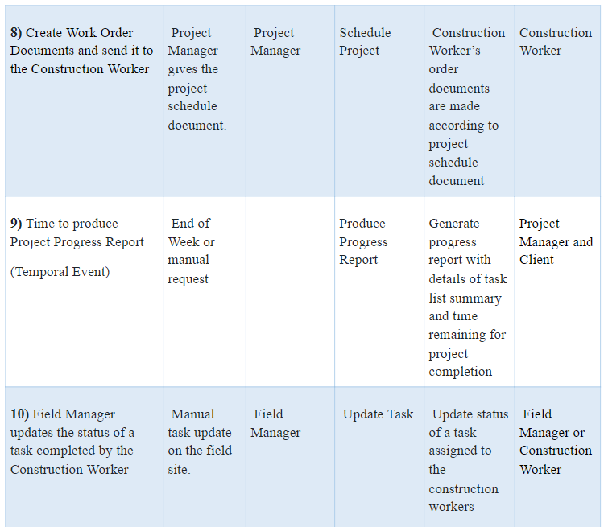
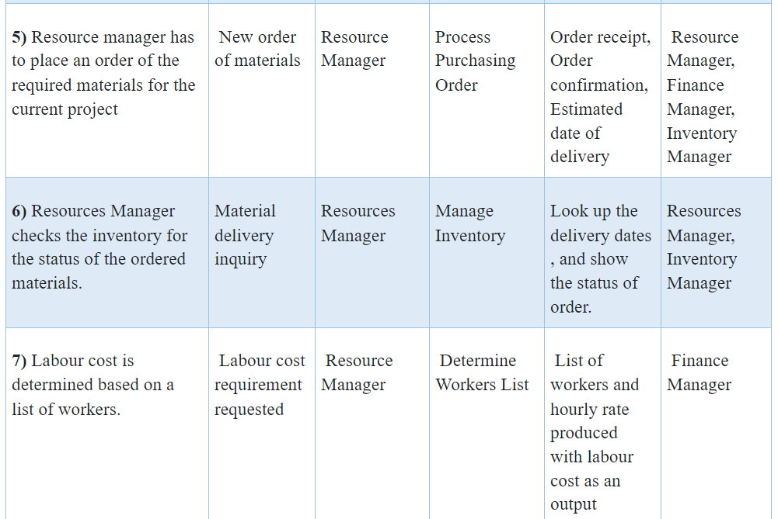
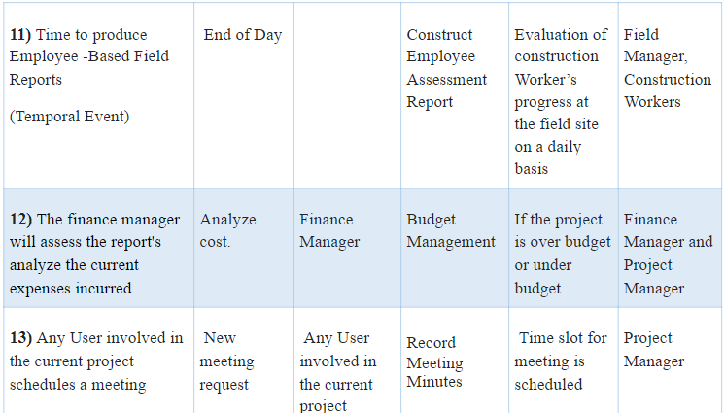
Events Table

Slide 28

Confirm BluePrint

Slide 29
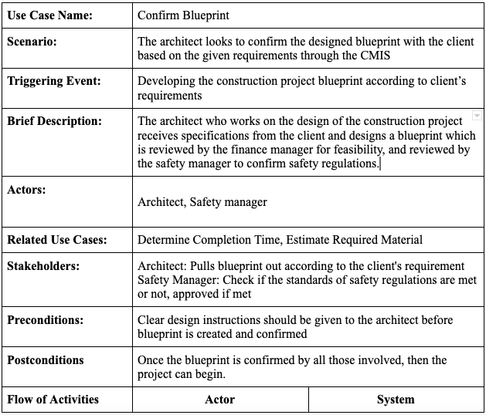
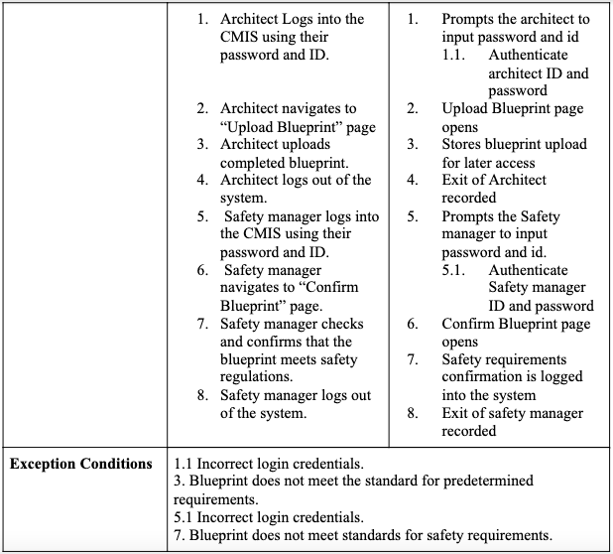
Use Case Description

Slide 30
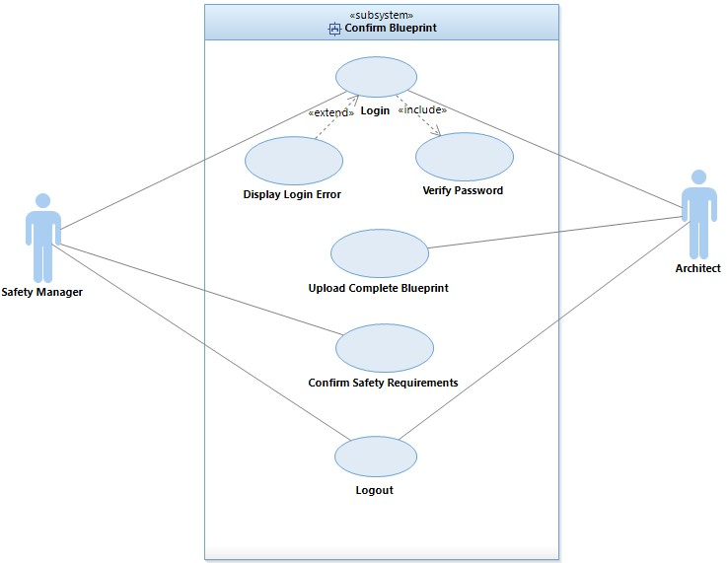
Use Case Diagram

Slide 31
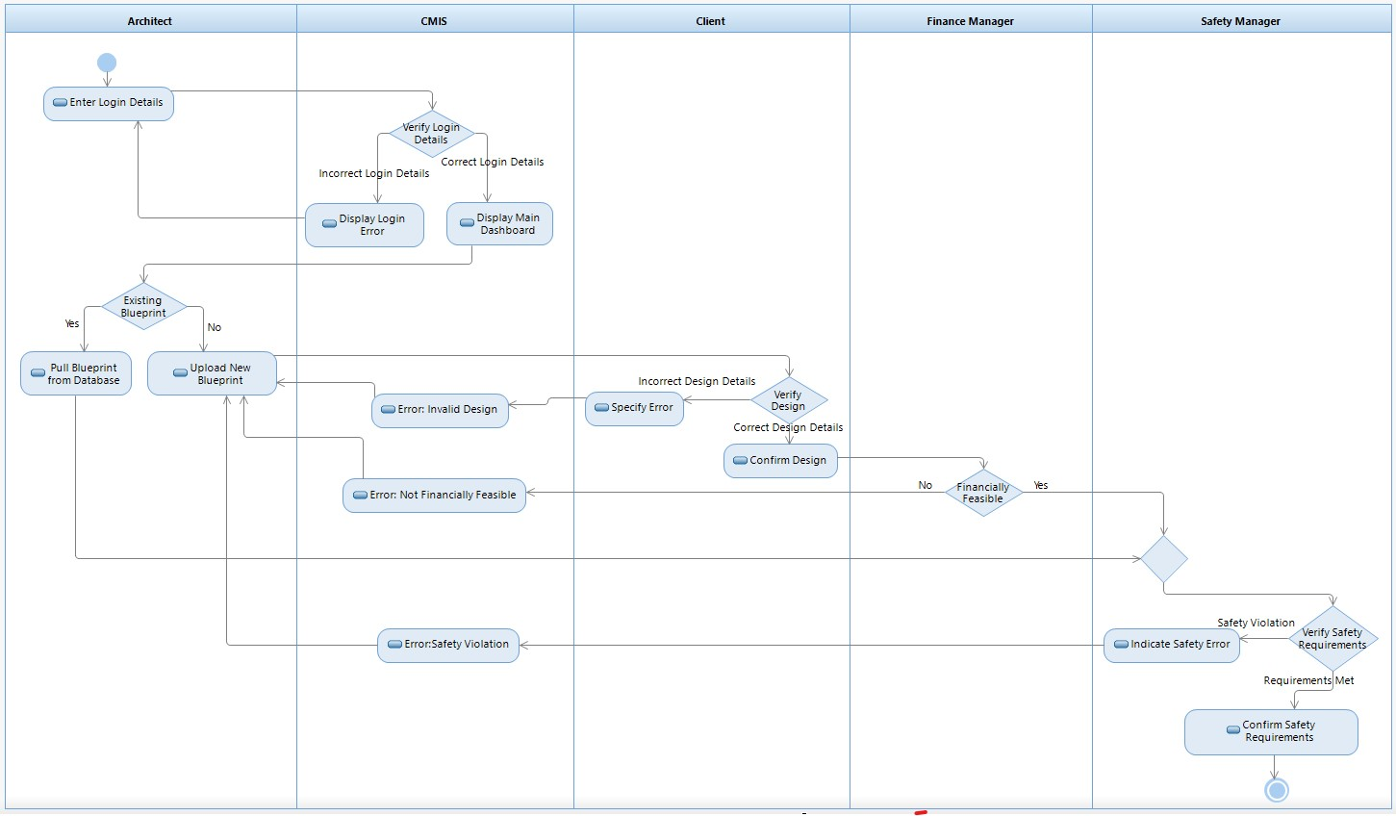
Activity Diagram

Slide 32

Process Purchasing Order

Slide 33
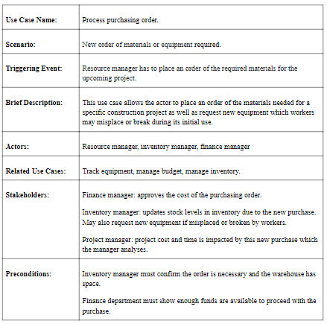
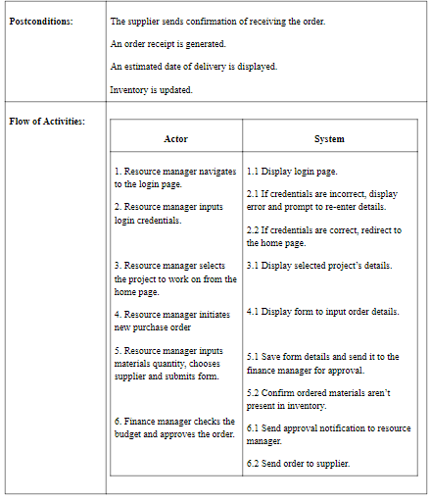
Use Case Description

Slide 34
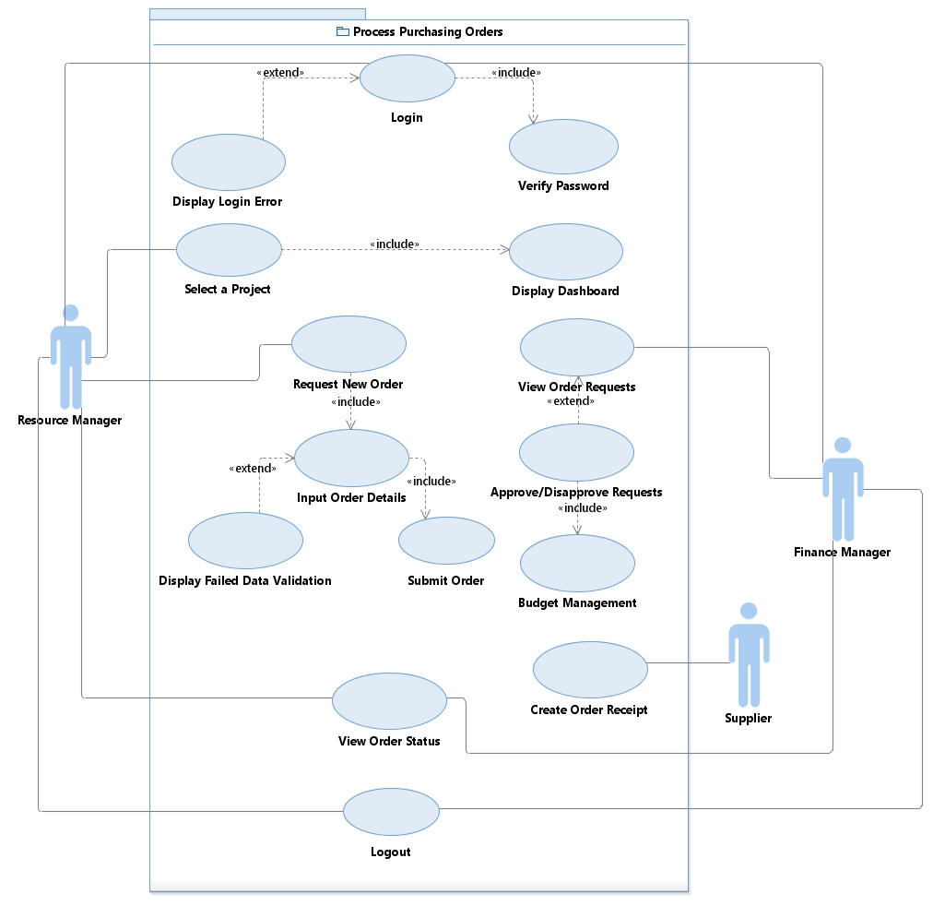
Use Case Diagram

Slide 35
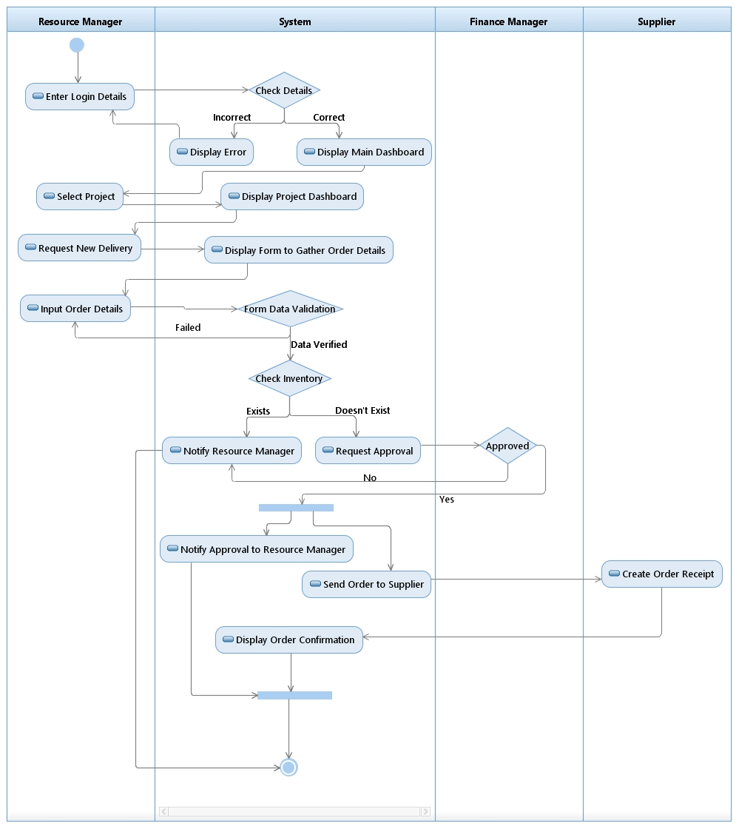
Activity Diagram

Slide 36

Produce Progress Report

Slide 37
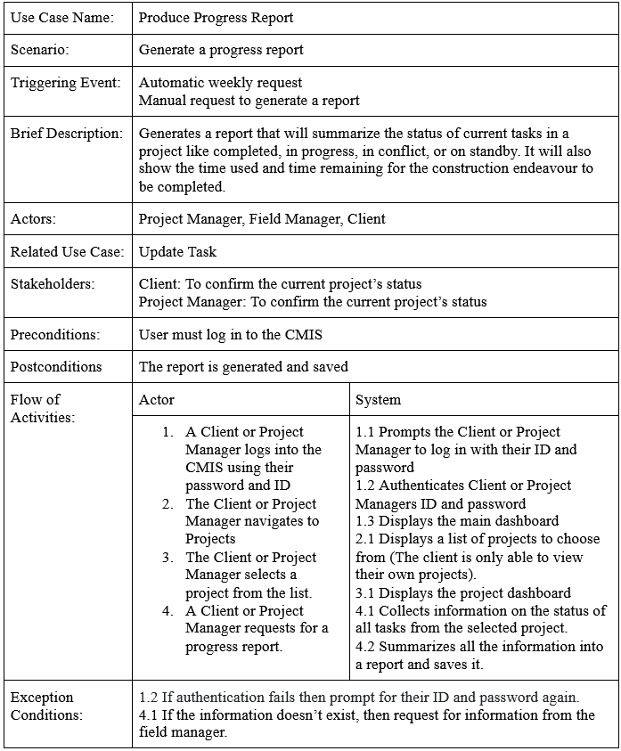

Use Case Description:

Slide 38
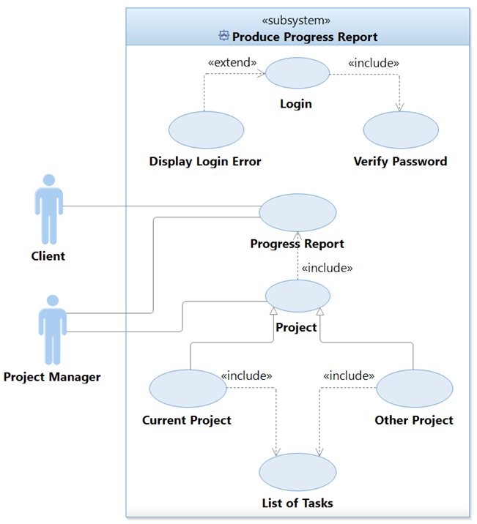

Use Case Diagram:

Slide 39
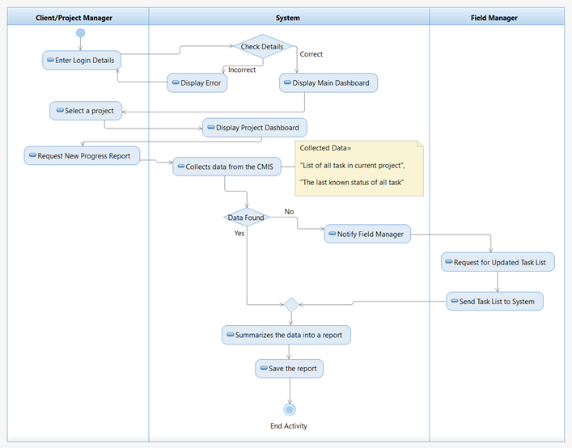
Activity Diagram: Produce Progress Report

Slide 40

Budget Management

Slide 41
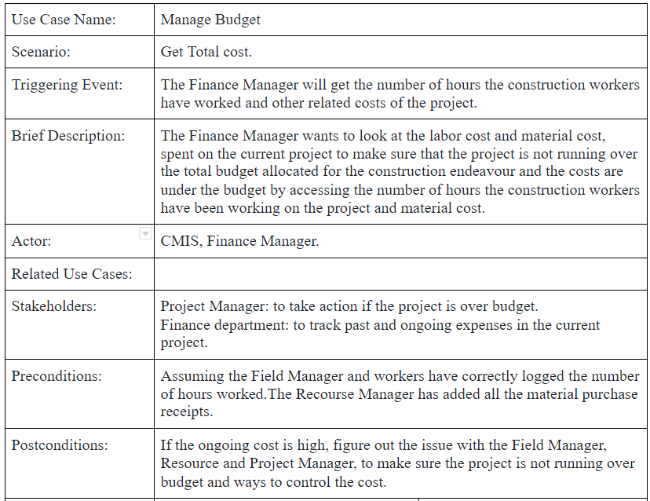
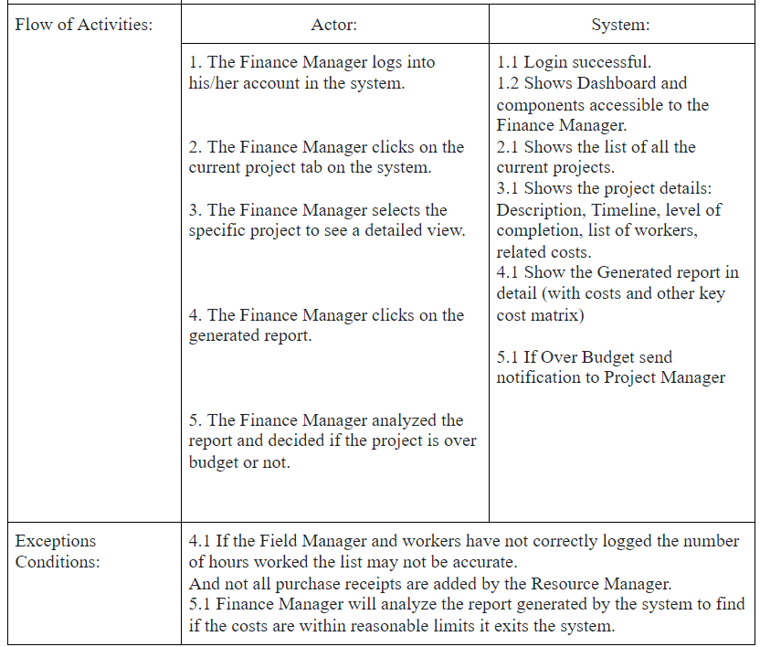
Use Case #12:Manage Budget

Slide 42
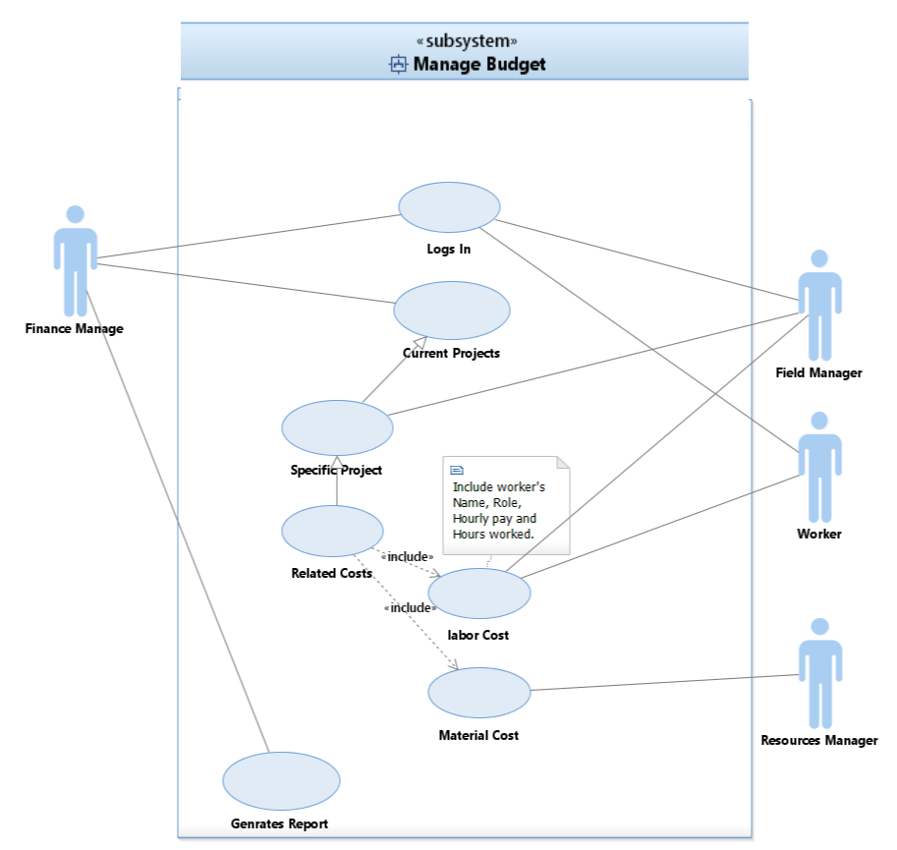

Slide 43
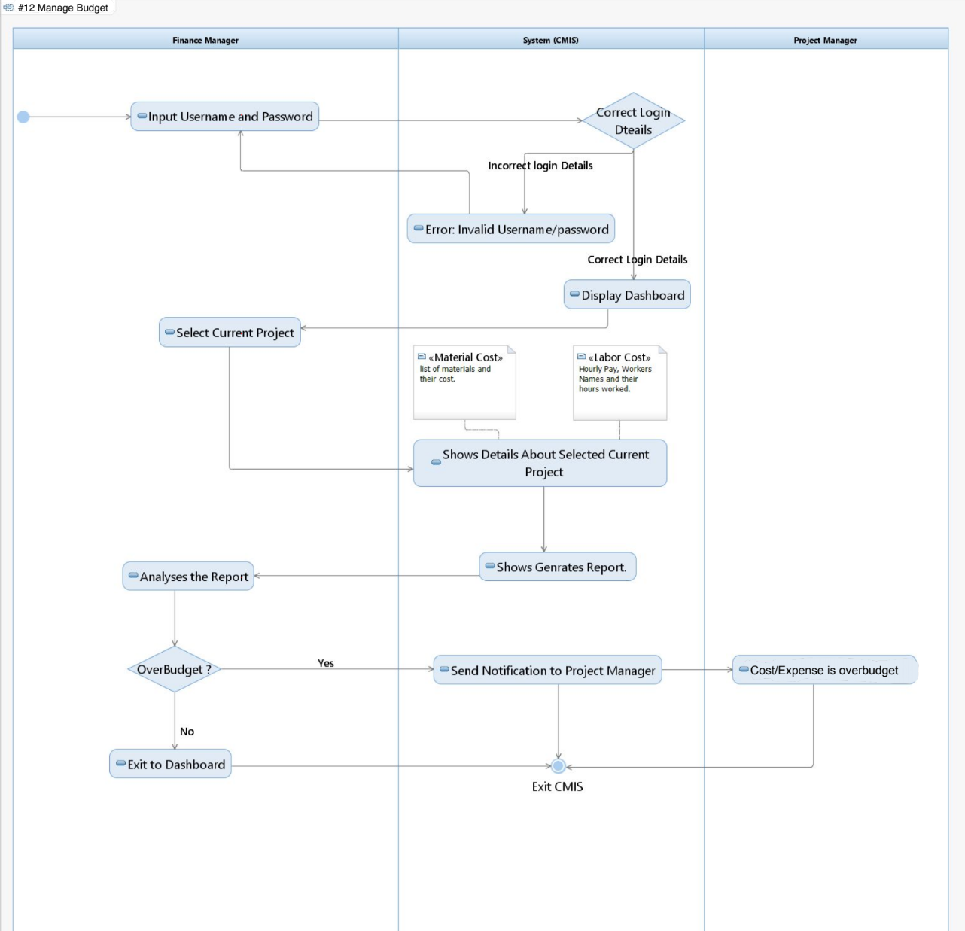

Slide 44
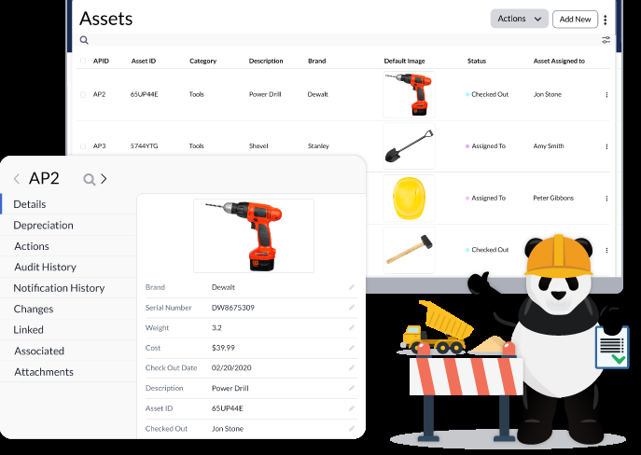
Tracking Equipment

Slide 45
Brief Description
Construction Workers request for the equipments to be used on the field site for the completion of their task or development of the project.
The inventory manager keeps track of the equipments being used for the project and will update the status of the equipment being used.
The inventory manager will say “not available” in two scenarios:
If the equipment is not available in the inventory
If the equipment in the inventory is all used by the workers at that point of time.
Inventory manager will also make sure that all the equipment used for the development of the project is returned at the end of the day. The condition of the returned equipment is noted as well and necessary actions are taken accordingly.

Slide 46
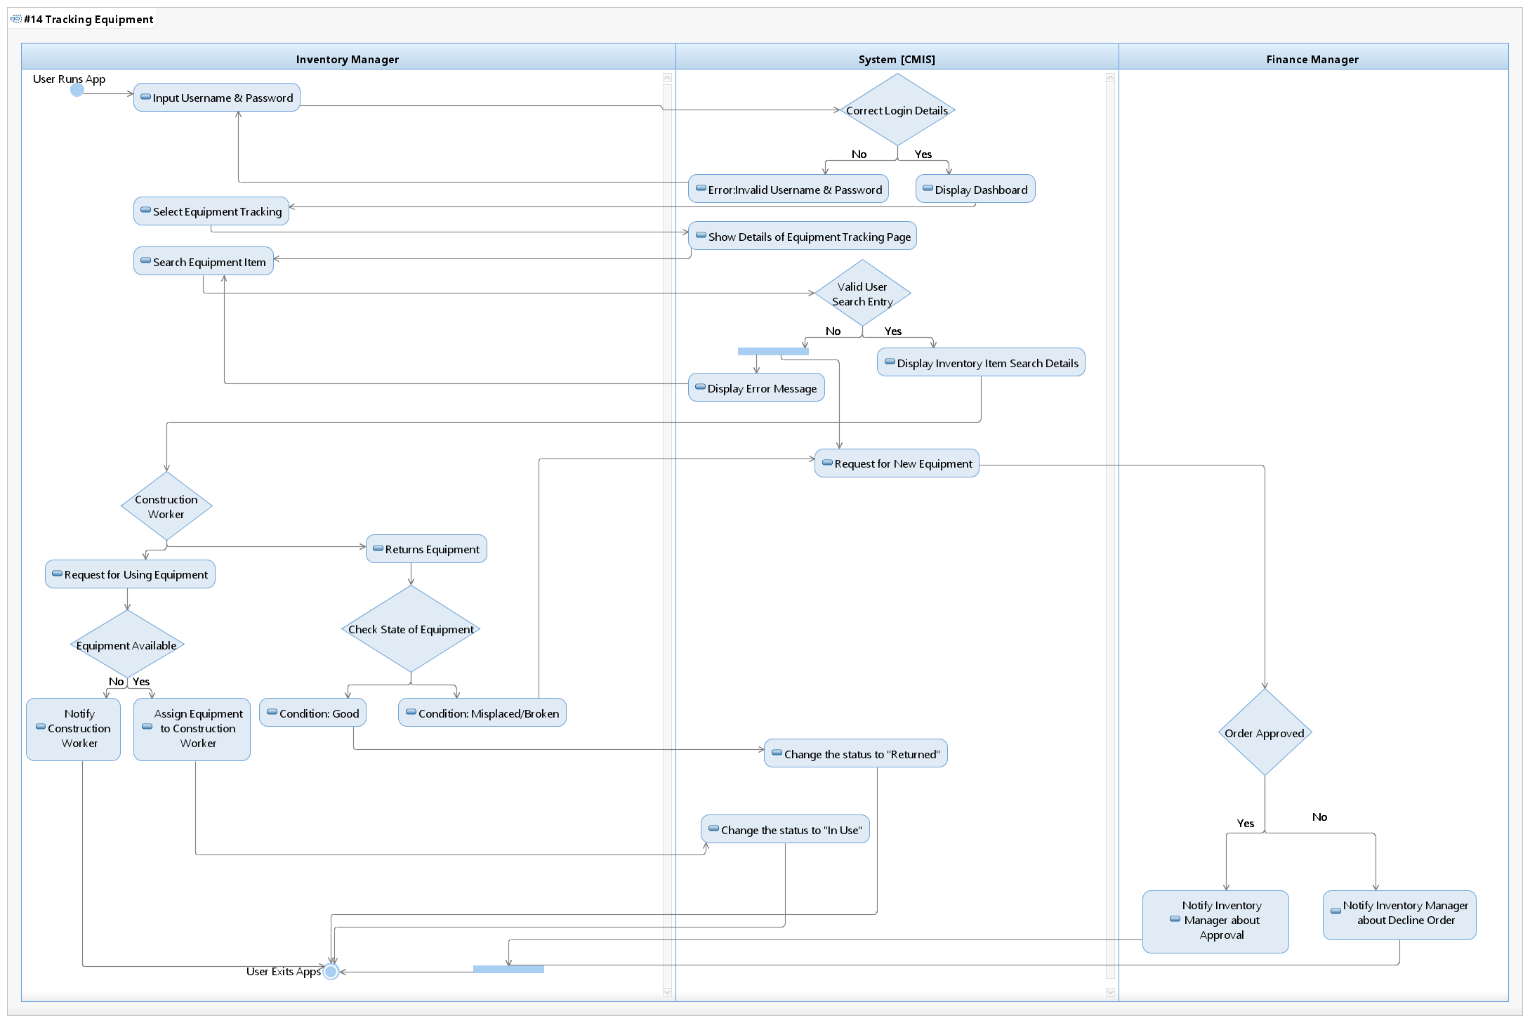
Activity Diagram: Flow of Activities between Actors & CMIS

Slide 47
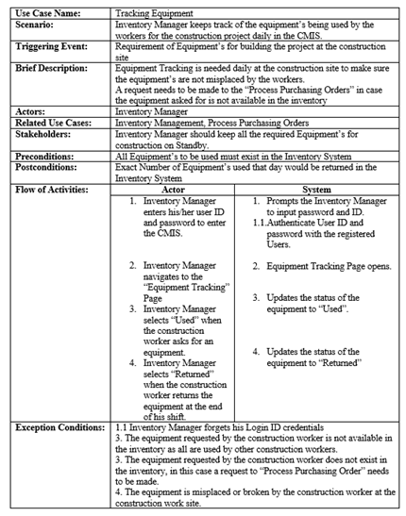
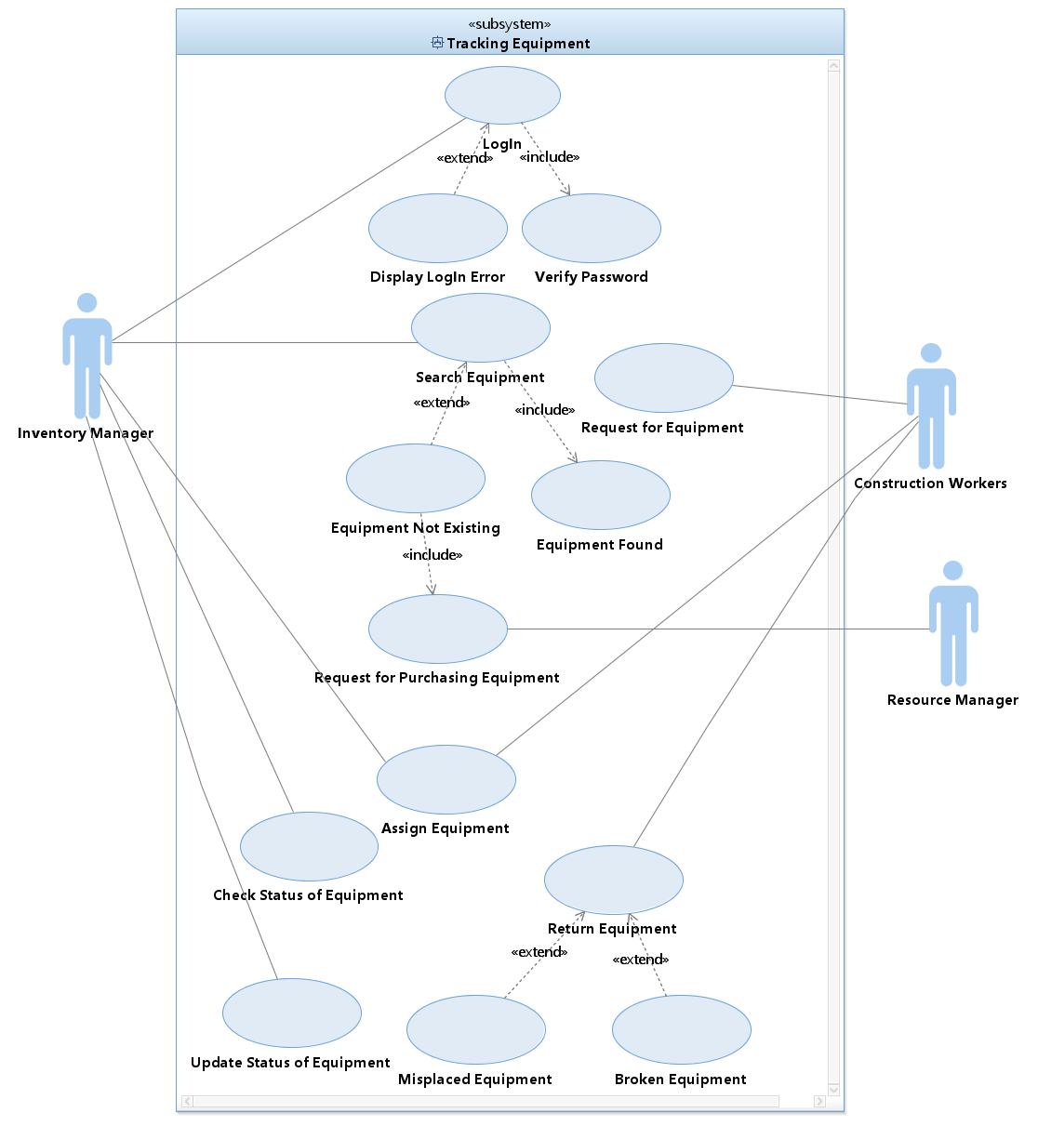
USE CASE SPECIFICATION & DIAGRAM

Slide 48

Schedule Project

Slide 49
Brief Description
The project manager will validate the project schedule generated by the system and will assign it to the field manager.
The field manager will assign work orders to each construction worker.
The construction worker gets notified about their assignment and information.
The construction workers can request for change in the task completion time or request for a new task and the field manager will make a decision on the request and updates the work schedules

Slide 50
Flow of activities
Users
Project manager inputs the project deadlines along with the project description report.
The project manager will validate the project schedule and will make some changes if necessary and will assign it to the field manager.
The field managers will assign tasks to each construction worker.
The Construction Workers view their tasks along with instructions, deadline, and priority
Construction workers requests for updates in the work schedules such as more time.
Systems
Generates a project schedule based on the requirements.
Updates the project schedule with deadlines and priority.
Generates work Order for the field manager to assign tasks.
System displays the Construction Worker tasks arranged by deadline or priority.
Noties field managers with Construction Worker requests and allow managers to update the task based on their decision.

Slide 51
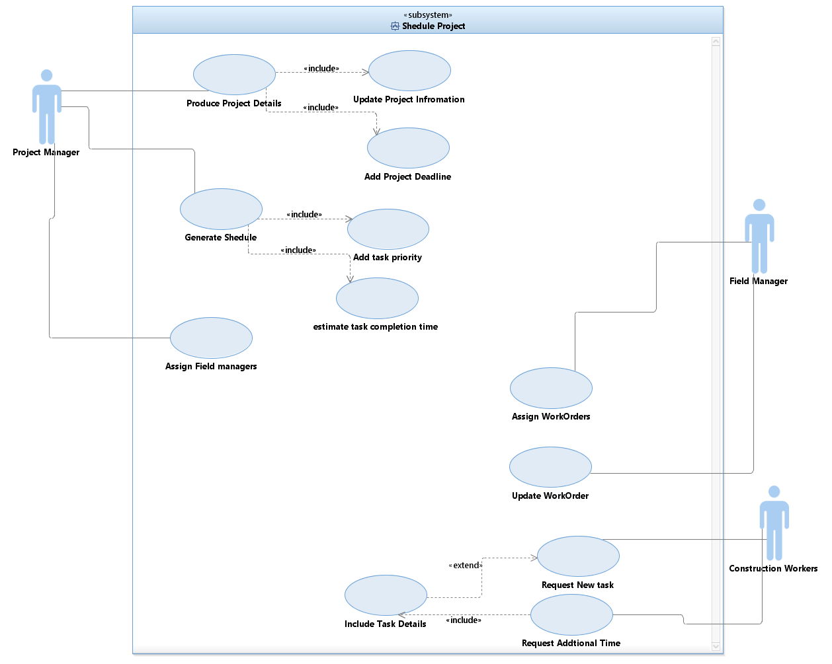
Project Schedule
Use Case Diagram

Slide 52
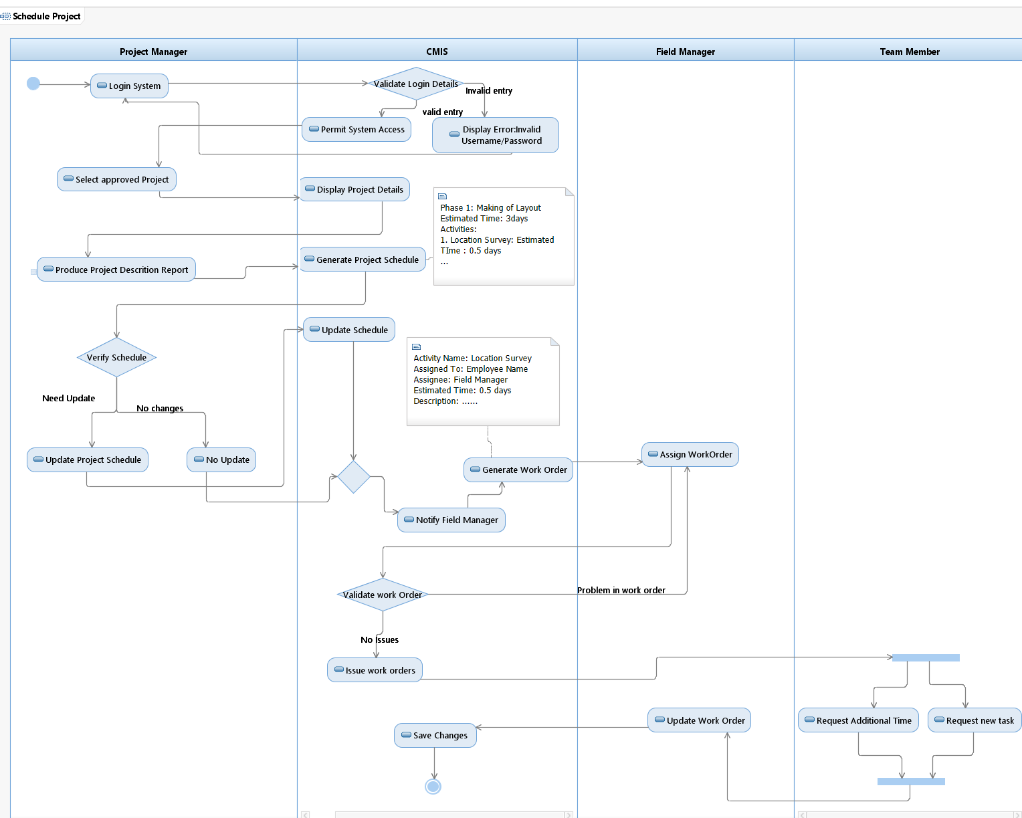
Activity Diagram

Slide 53
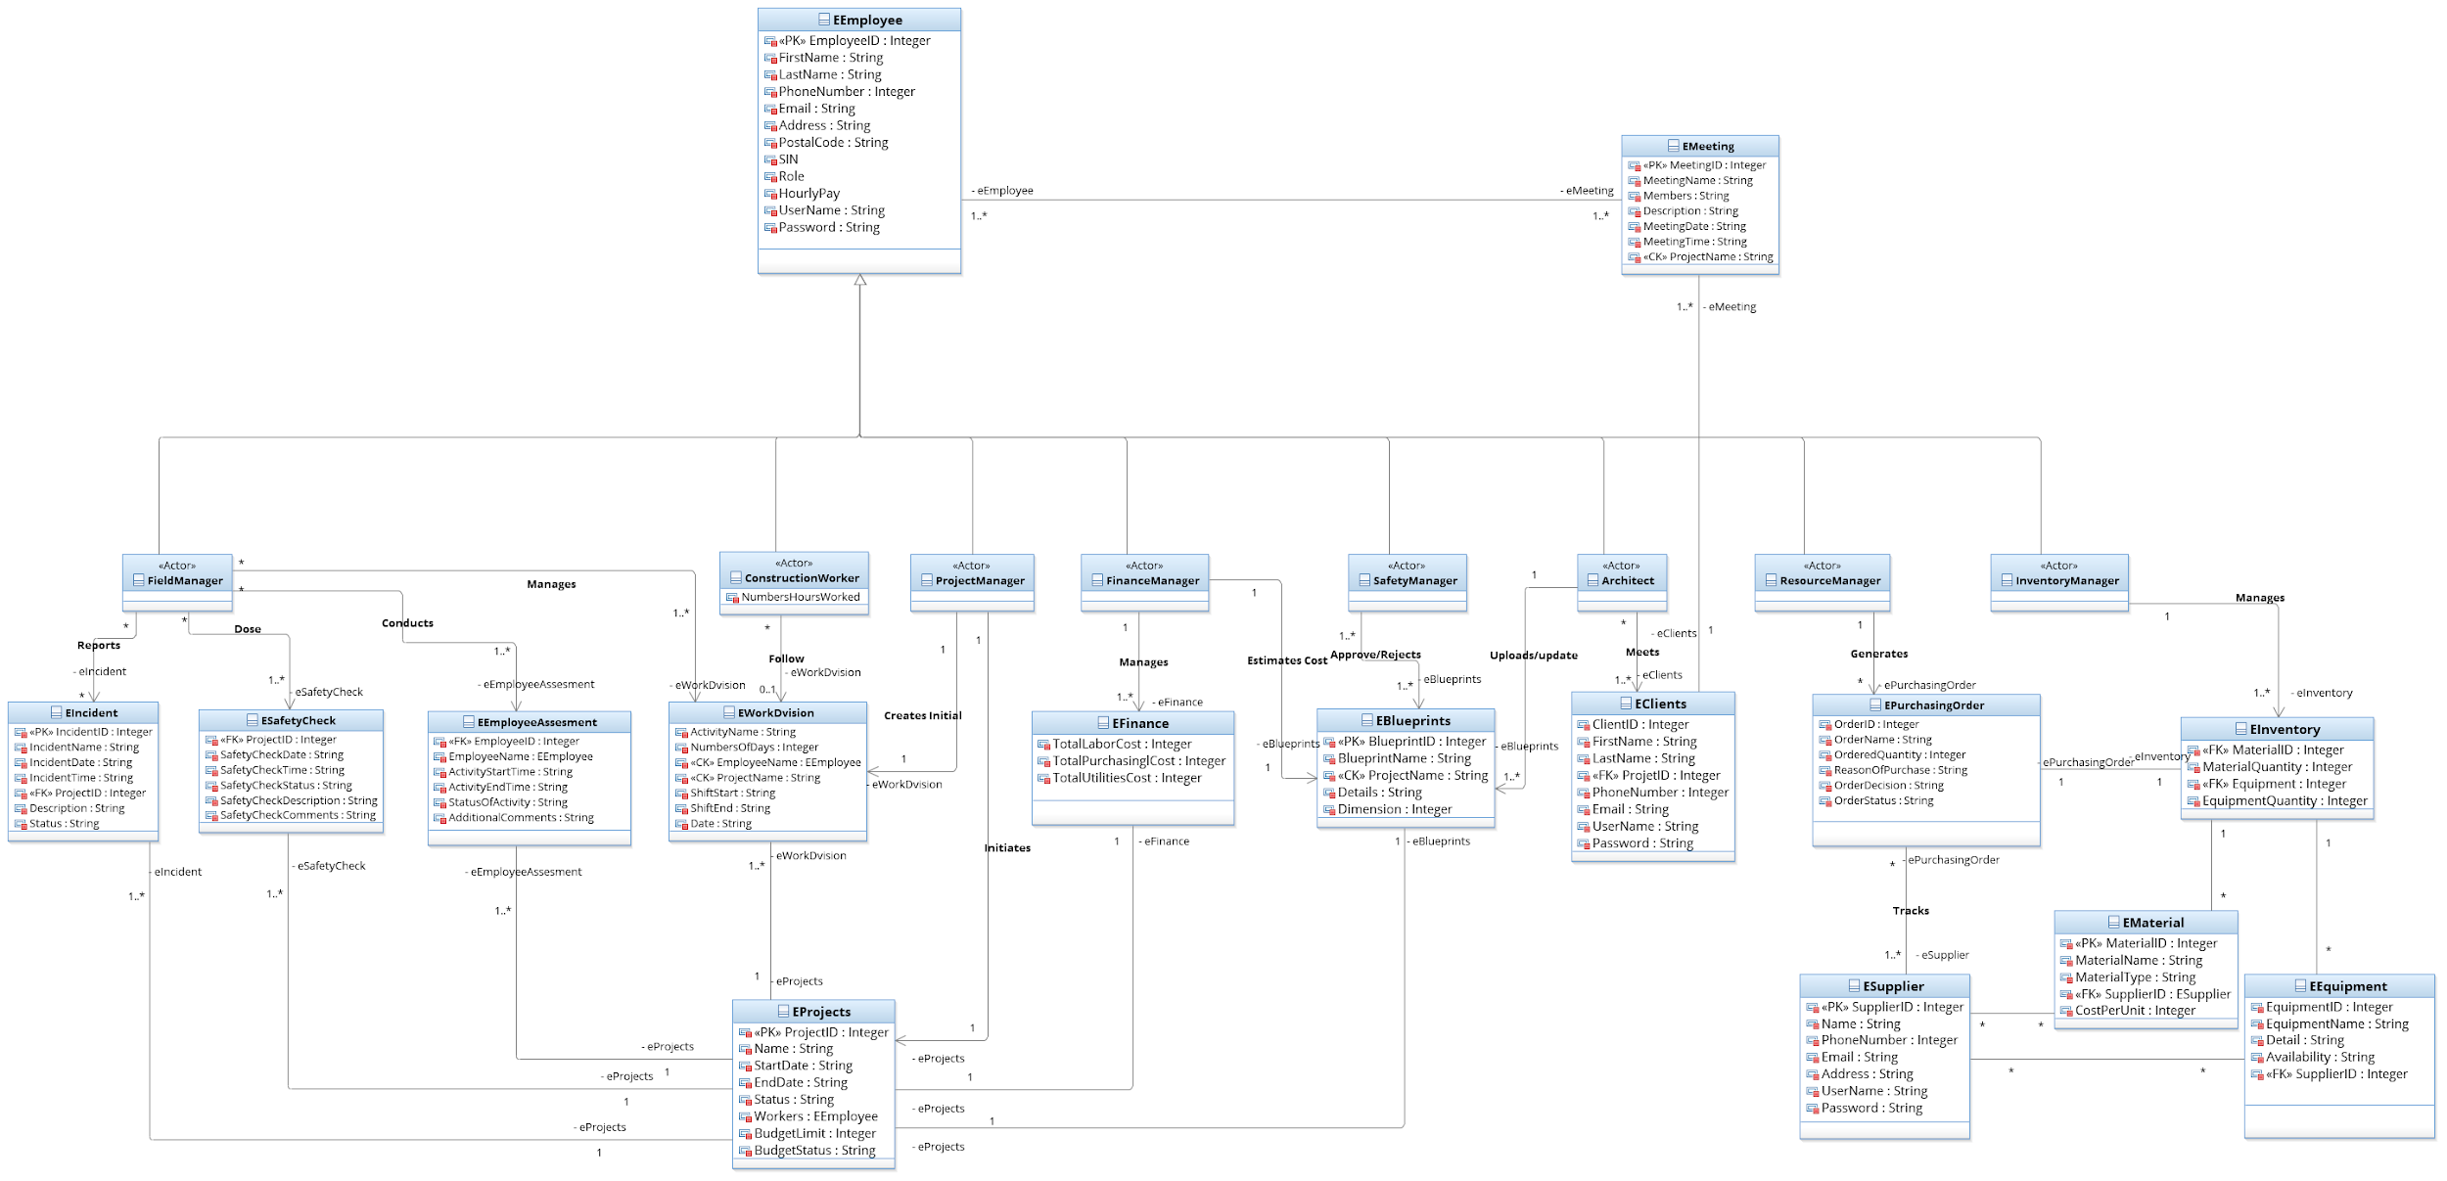
Conceptual Model

Slide 54


Questions ?

